Slide 1
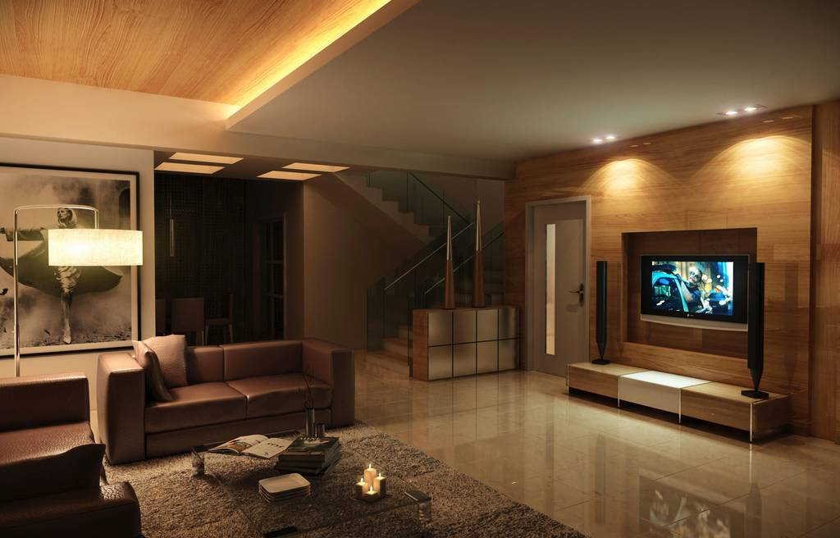
FIRST SPANISH ASSEMBLY OF GOD
“ VISION CELESTIAL “
VIGILIA DE MUJERES
VIERNES 10 DE JULIO - 7:00 – 11:00 P.M.
TEMAS: “ UNA MUJER DE PODER “
“ UNA MUJER PERSISTENTE “
“ BUSCANDO TU LUGAR EN EL REINO “
This Photo by Unknown Author is licensed under CC BY-NC-ND

